Slide 1
RED SPARKLE TEST

Slide 2
1. Can you write the numbers 1 to 20 on your board please?

Slide 3
2. How many cakes are there on the board?

Slide 4
3. On your Whiteboards can you put these numbers in order? 18, 6, 13, 4

Slide 5
4 – What is one more than 15? What is one less than 7? What is one more than 11?

Slide 6
5– Can you write the numbers a)nine b) six c) eight as digits please?

Slide 7
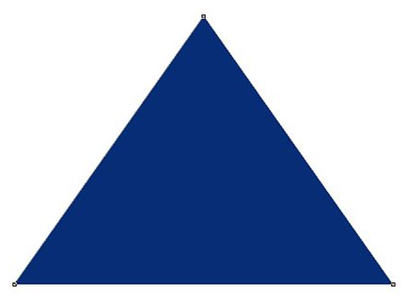
6- Can you split these objects in to 2 different groups ? Can you write it as a number sentence?

Slide 8
7. Can you estimate how many dinosaurs I have here without counting them?

Slide 9
8. How many sweets have I got in total?

Slide 10
9. - If Mr Collins took 3 of my sweets from the bag how many would I have left?

Slide 11
10. - On your Whiteboards: a) What is double 4 ? b) What is double 7?

Slide 12
11. 6+3=? 4+5=? 3+5=?

Slide 13
12. On your Whiteboards can you tell me what each digit means in the number 18? 18 ? ?

Slide 14
13. What do I need to add to these numbers to make 20? a) 5 d) 11 b) 6 e) 12 c) 7 f) 13

