Slide 1
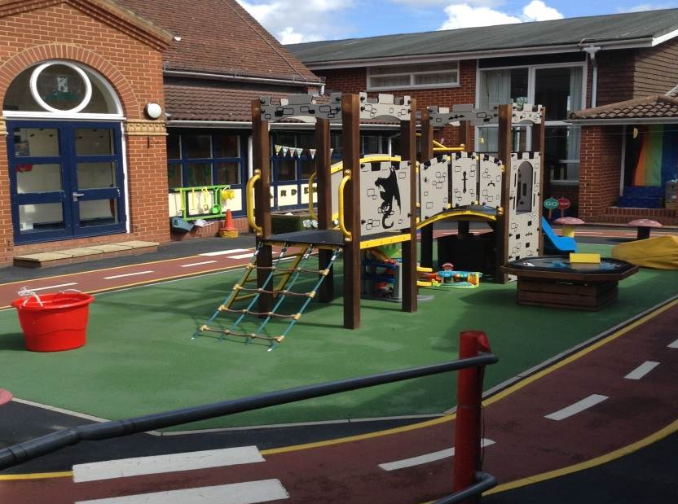
Tower Hill Primary School Early Years Induction Information 2022

Slide 2
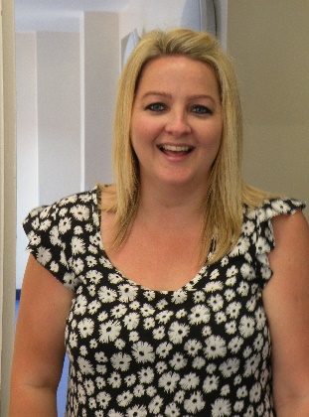
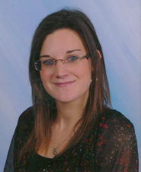
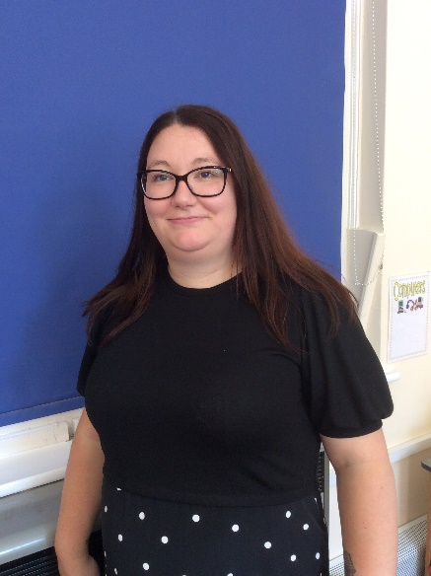
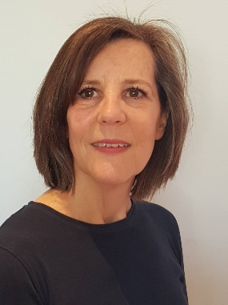
The Early Years Team
Class Teachers
Mrs Wilcox Miss Ramsier
Learning Support Assistants
Mrs Deans Mrs Goel Mrs James

Slide 3
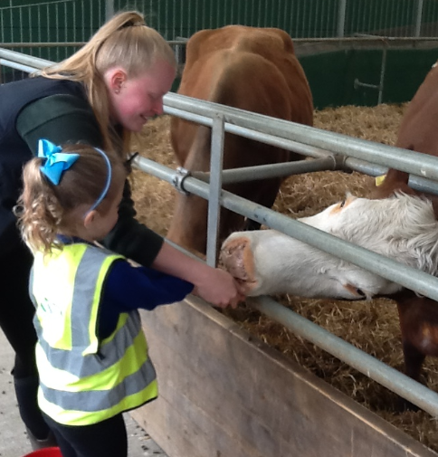
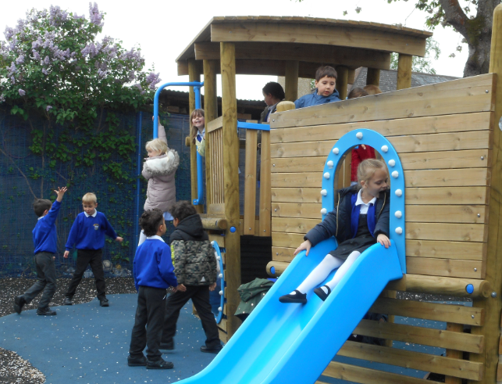
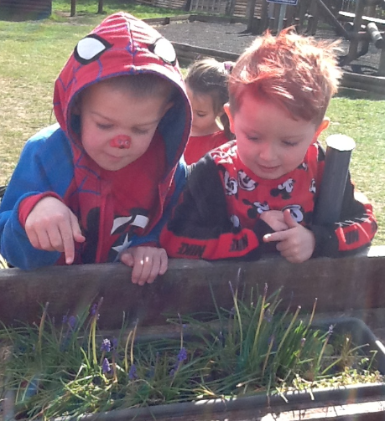
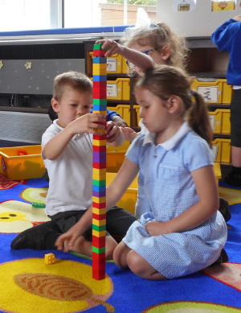
Getting to know You
All About Me and many other forms
Pre-school/
Nursery communiation

Slide 4
When will your child start school?
Summer Birthday
These children will start school on Monday 13th^{th} September from 8.50am and will stay until 3.20pm
Spring Birthday
These children will start school on Tuesday 14th September from 8.50am and will stay until 3.20pm
Autumn Birthday
These children will start school on Wednesday 15th September from 8.50am and will stay until 3.20pm

Slide 5
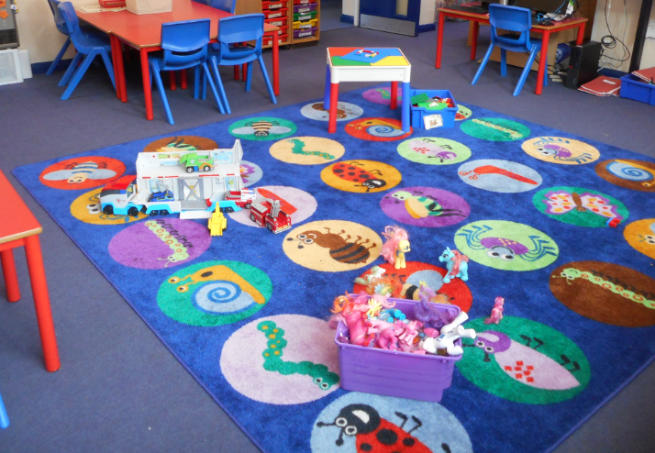
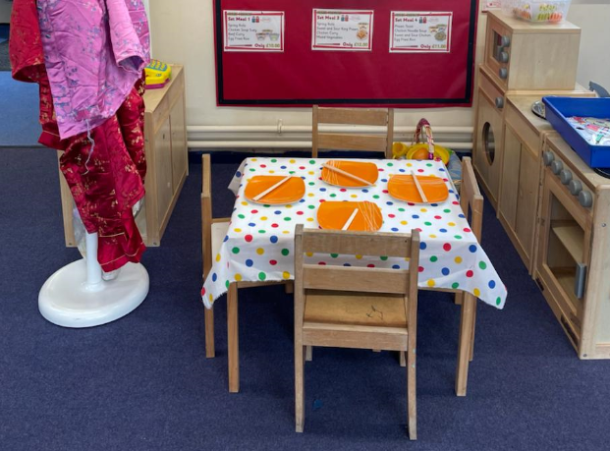
Stay and Play Visits
Your child is invited to attend 4 stay and play visits to their new class at Tower Hill Primary School on:
Visit 1- Stay and Play Thursday 9th June 1.30-2.30pm
Visit 2- Stay and Play Thursday 16th June 9.30-10.30am
Visit 3- Stay and Play Thursday 7th July 10.30-12noon
Visit 4- Stay and Play Thursday 14th July 1.30-3pm
Visit 5 – Stay and Play Friday 9th September 1.30pm-3pm
Home visits will take place during the week of 5th September

Slide 6
Tapestry
Online Learning Journey to track and assess the children throughout Reception
Staff and Parents can use to log observations of the children
Details of how to activate your account will be sent soon.

Slide 7
ParentMail
All communication sent via ParentMail
Payments taken via ParentMail
Forms
School Uniform orders

Slide 8
When will your child know which class they will be in?
Two classes Sears and Pisa
Children will be in classes for second Stay and Play session where final decisions on classes will be made
Home visits will take place during the week of 5th September

Slide 9
What happens on the first day?
Classroom doors will open at 8:50 and children have a 10 minute window to enter their classrooms
9:00 classroom doors close
Dismissed near the classroom doors
as at Stay and Play
Promote Independence
Member of Early Years always on the door

Slide 10
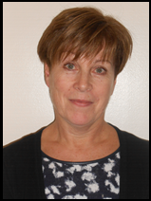
Support Workers
Family Support Worker – Gail Meaney
SENDCo – Christine Cartlidge
Pre-School Link Worker – Kate James

Slide 11
Absences
We request early notification of absences by a telephone call to the office or via ParentMail.
Official holiday request forms are available from the school office.
It is at the Head teacher’s discretion whether an absence is authorised but these can only be granted in EXCEPTIONAL &/or UNIQUE CIRCUMSTANCES.

Slide 12
Late Arrivals
If for some reason you arrive late to school (after 9.00am when classroom doors are shut for the safeguarding of all children) please bring your child round to the office.
You will be asked to complete an entry into the ‘Late Book’ so that the office team can ensure children are marked on the register and their lunch is booked.
Persistent lateness is treated in the same way as unauthorised absence.

Slide 13
Medical Information
It is very important that any serious illnesses and allergies are clearly indicated on the ‘All About Me’ form. It is also vital that the school has an up-to-date address and telephone number where you, or someone of your choice, can be reached in an emergency.
We will always administer or oversee asthma medication or any prescribed medication. To do this we will need you to complete a consent form, please ask in the office.
If your child has actually been sick or had a stomach upset, please keep them at home for 48 hours before returning them to school.

Slide 14
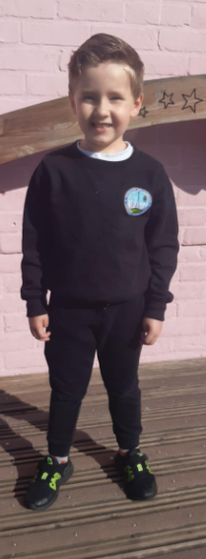
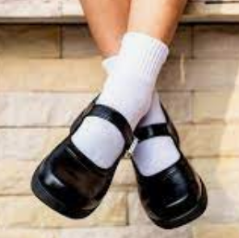
School Uniform
Smart Award!

Slide 15
Please ensure all your child's
belongings are clearly named!

Slide 16
Book Bags
Book bags can be purchased from the school office.
These bags not only protect school books, but also help to ensure that your children’s amazing pictures they create in school come home safely ☺

Slide 17
School meals
Packed lunch or school dinner.
School dinners are now free to all children in the Early Years and Key Stage One.
You will receive a termly menu so you can help your child to choose a school dinner. They will be asked to select from a choice of three nutritious meals every morning. One of these meals is always a vegetarian option.
Arrangements can be made for children with allergies.

Slide 18
Pupil Premium
Depending on the benefits that you receive can mean that your child is ELIGIBLE for Free School Meals
ALL Early Years and ‘Infant’ (Key Stage I) children are now ENTITLED to INFANT Free School Meals
If you are ELIGIBLE for FSM, your child will be able to attend our Breakfast Club from 8.00am until 8.45am
A nutritious breakfast + playing games and/or using the IT Suite – all supervised activities
Support for School Visits – which we value highly and include across our whole school curriculum
Additional Adult Support in the classroom which is so valuable to support children’s development
Even if you are unsure whether you are entitled – please fill it out anyway!

Slide 19
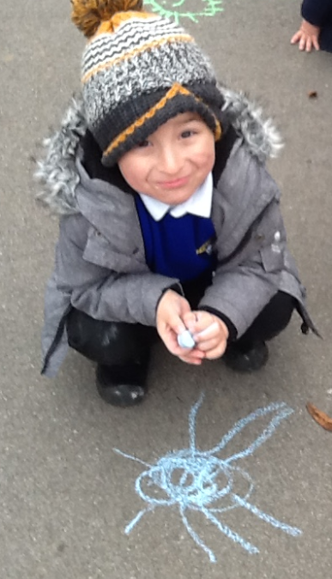
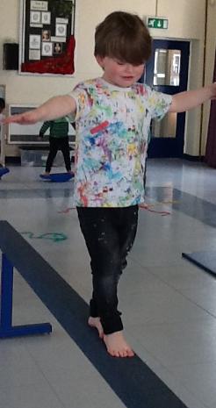
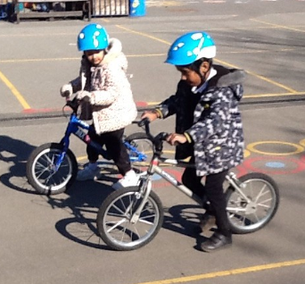
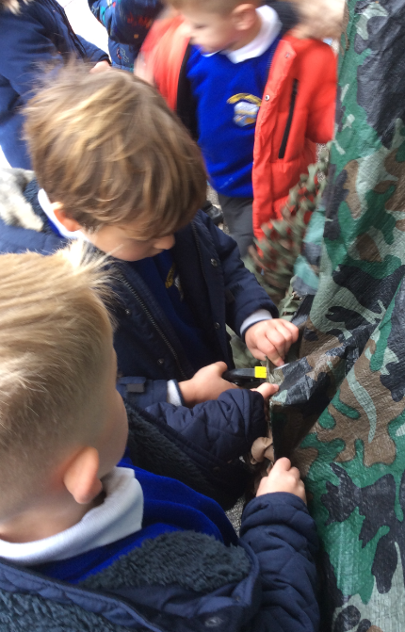
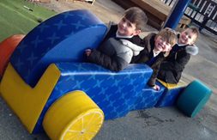
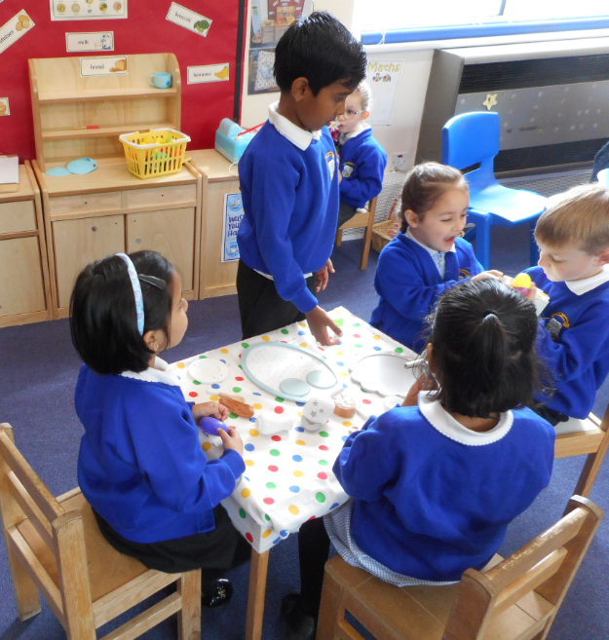
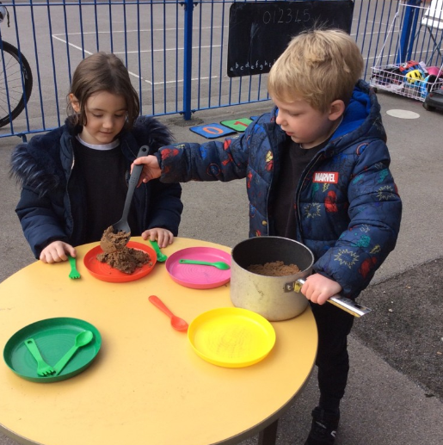
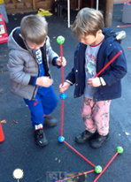
The Early Years Curriculum
Much of your child’s early learning will take place through play.
The curriculum is split into 7 areas of learning.
Physical Development
Communication and Language
Personal, Social and Emotional Development

Slide 20
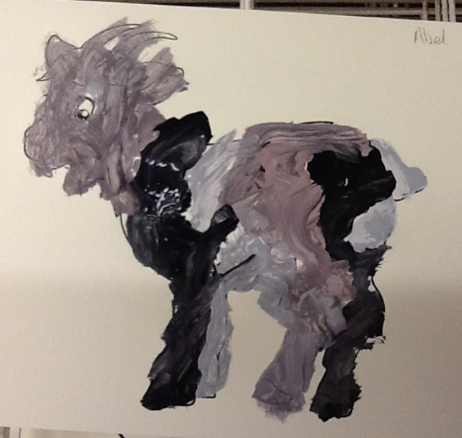
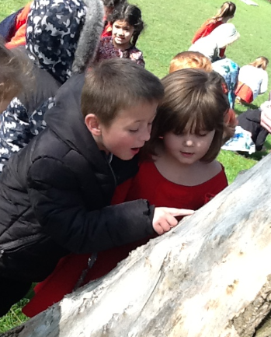
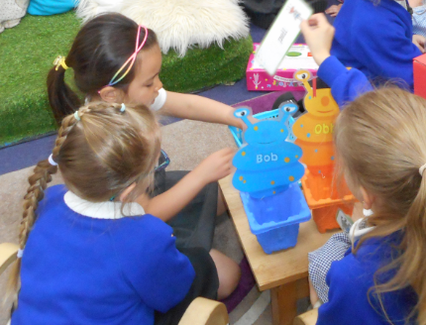
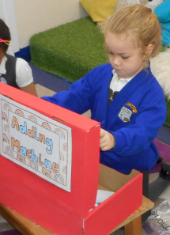
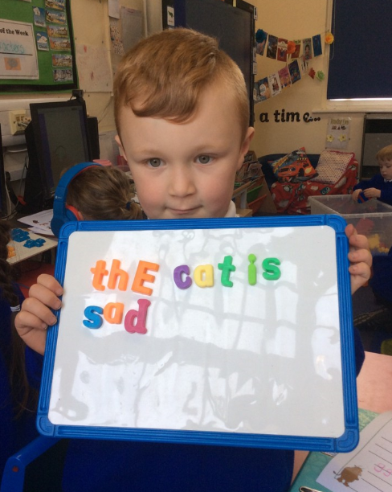
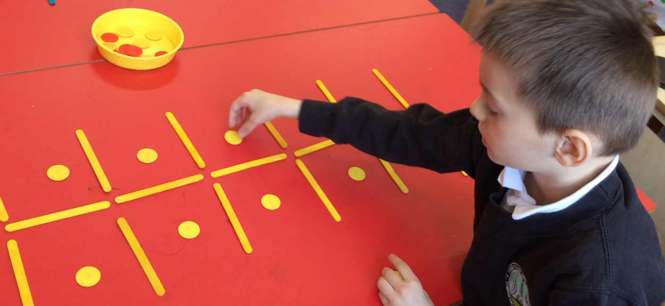
Understanding
of the World
Literacy
Expressive Arts and Design
Mathematics
We will share more information on our curriculum in the Autumn term

Slide 21
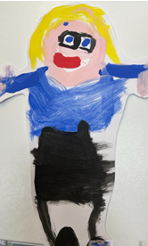
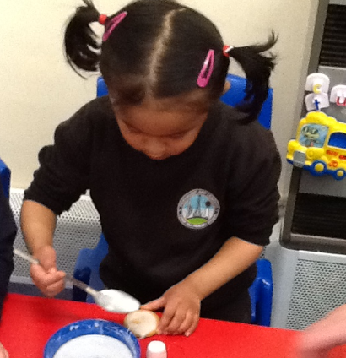
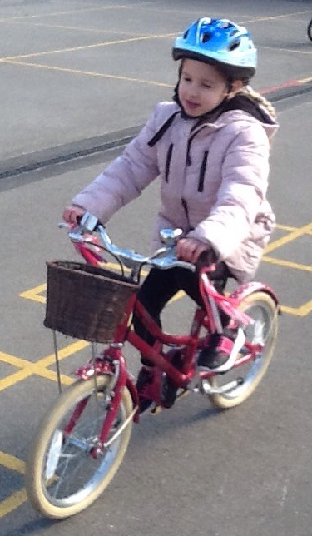
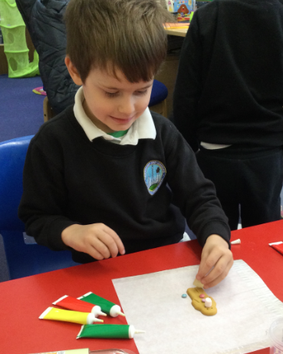
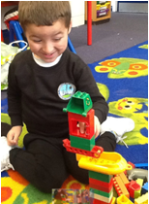
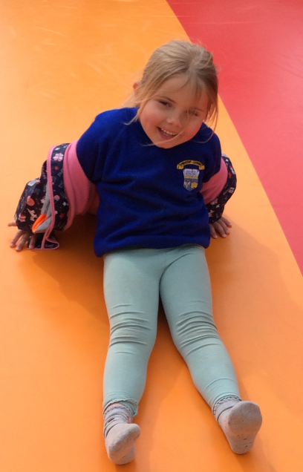
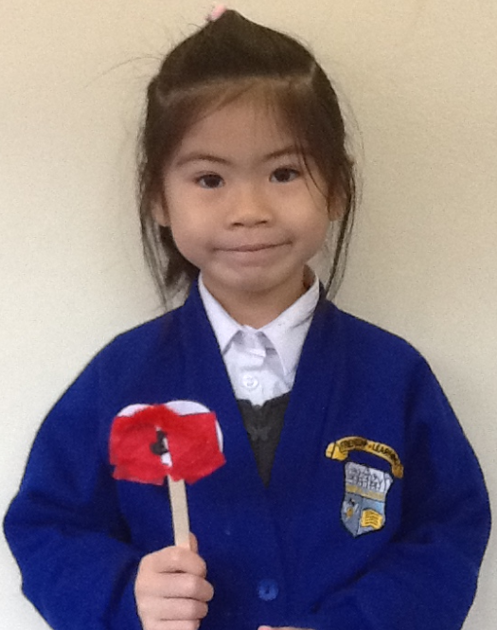
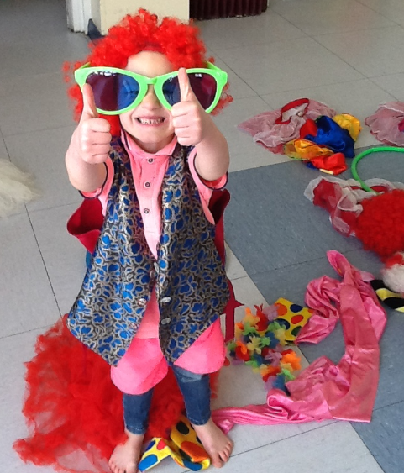
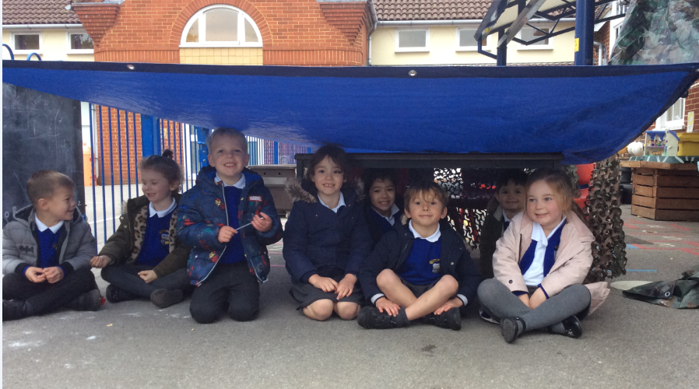
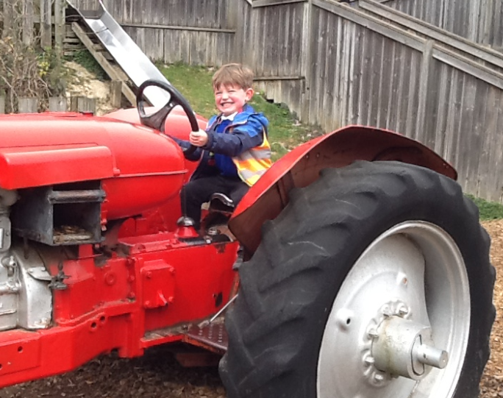
Fun!

