Slide 1

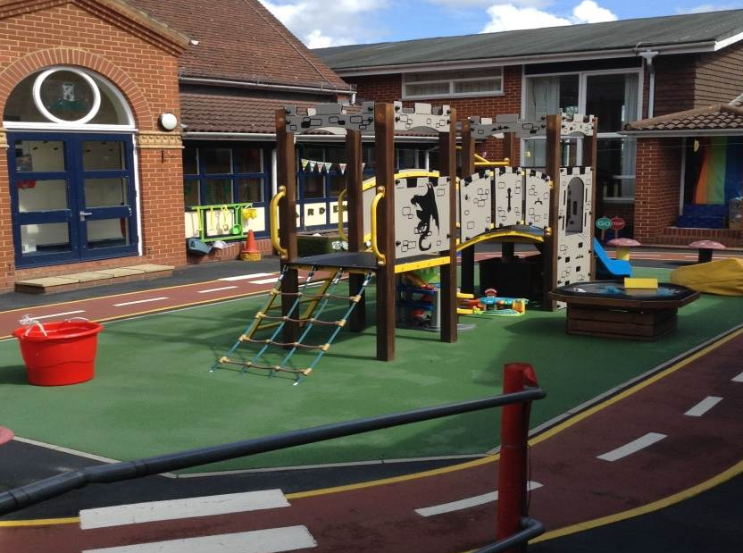

Tower Hill Primary School
Early Years
Induction Information 2020
Notes:
Laura O to introduce

Slide 2
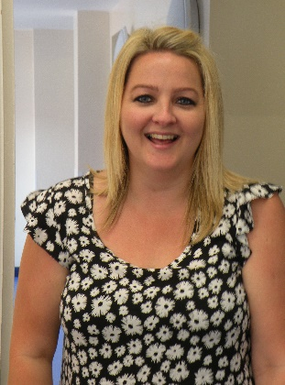
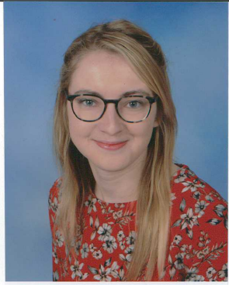
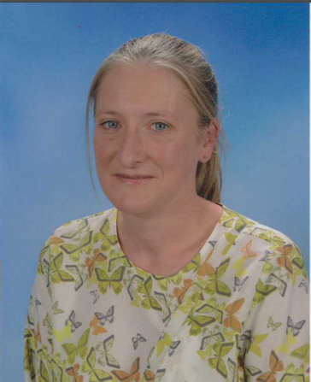
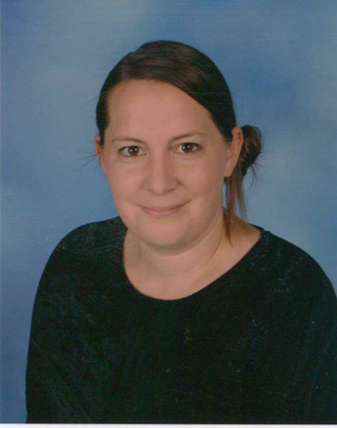
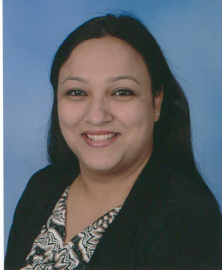
The Early Years Team
Early Years Leader Class Teachers
Mrs Elliott Mrs Wilcox Miss Carter
Learning Support Assistants
Mrs Maidment Mrs Durkin Mrs Goel
Notes:
Laura E

Slide 3
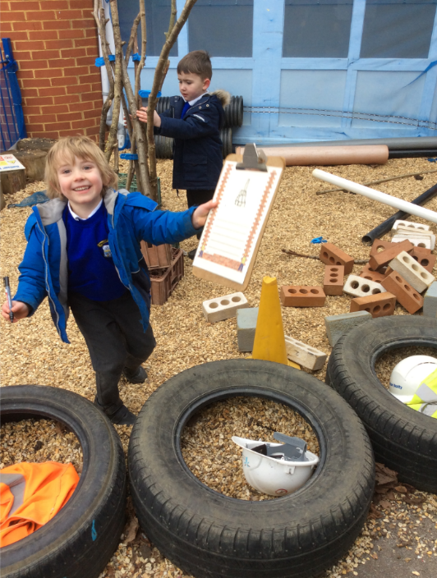
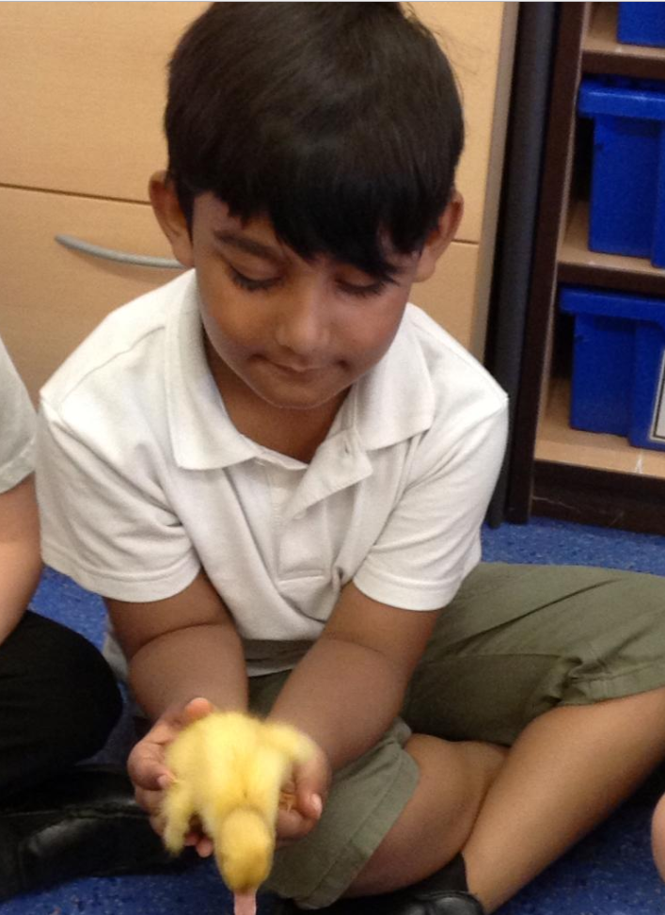
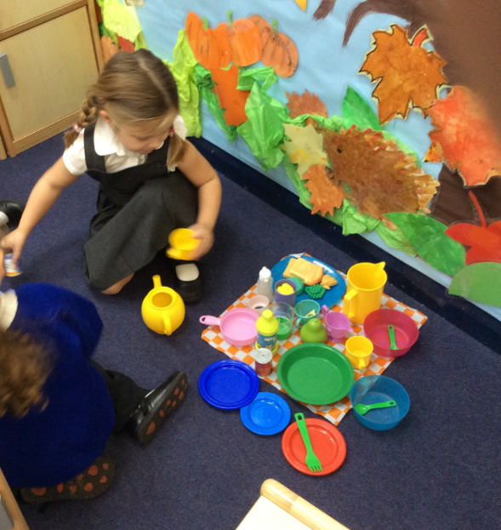
Welcome
Starting School pack – everything you need to know!
All About Me form
Pre-school/
Nursery communiation
Notes:
Laura E
Starting School Pack – Includes whole school handbook
Everything you need to know about starting school
All about me – Information - getting to know your child – family, things they can do, family traditions, likes,
Return on - Monday 17th ^{at stay and play session}
Pre-school/Nursery – Positive relationships with Pre Schools and Nurseries. PSLW contacting all settings to gather information on all children coming to Tower Hill. Use of Tapestry. Work with them to make sure transition is smooth.

Slide 4
When will your child start school?
Red Sticker
These children will start school on Monday 14th^{th} September from 9.00am and will stay until 3.20pm
Yellow Sticker
These children will start school on Tuesday 15th September from 9.00am and will stay until 3.20pm
Green Sticker
These children will start school on Wednesday 16th September from 9.00am and will stay until 3.20pm
Notes:
Laura E
Read sticker colour and dates
Remind them usual start time is 9.00am
Staggered start date to help settle children
Teach rules and routines of school life
Get them familiar with the setting

Slide 5
Stay and Play Visits
Your child is invited to attend 4 stay and play visits to their new class at Tower Hill Primary School on:
Visit 1- Stay and Play Tuesday 8th September
Visit 2- Stay and Play Wednesday 9th September
Visit 3- Stay and Play Thursday 10th September
Visit 4- Stay and Play Friday 11th September
Whilst your children are familiarising themselves with their new environment you will have the opportunity to meet informally with the Early Years staff and other new parents.
More information on sessions and timings to follow.
Notes:
Laura E
These will take place in September in smaller groups.
4 stay and play sessions - In year r classrooms with the 2 outside areas and art area, but in smaller groups. Children wil have the opportunity to attend s session in the morning and a session in the afternoon. The first visits will be with parents and the following visits will be without parents.
Your child will have a video call to meet their class teacher in July and this will be repeated in September before the Stay and Play sessions.

Slide 6
Tapestry
Online Learning Journey to track and assess the children throughout Reception
Staff and Parents can use to log observations of the children
Details of how to activate your account will be sent soon.
Notes:
Laura E

Slide 7
When will your child know which class they will be in?
Two classes Sears and Pisa
Short video on Tapestry to introduce themselves to your child.
No Home Visits this year – video call instead in the summer term.
Notes:
Laura E
Let you know when we have got to know the children
Tapestry – once registered and activated there will be a short video from the teachers. There will be a tour of the setting and some challenges to help get your children ready for school.

Slide 8
What happens on the first day?
The whistle blows at 9.00am and children are encouraged to line up near their classroom to go in to their class
There will also be adult supervision on the playground from 8.45am
Dismissed near the classroom doors
as at Stay and Play
Promote Independence
Member of Early Years always on the door
Notes:
Laura E
Doors open 9.00am
Adult supervision- Always adult supervision on playground, encourage parents to stay with child until 9.00am
Lining up- Line up by classroom door with class teacher. We will show you where to line up during Stay and Play sessions.
Independence Help children to hang things up etc
Try to get them to do it with encouragement
Encourage them to come in by themselves
Practice getting dressed etc at home over summer
Member of Eys Teacher to greet them
Adults in corridor and classroom
Familiar faces
Adult to take them if upset/cuddle

Slide 9
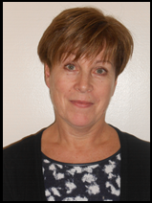
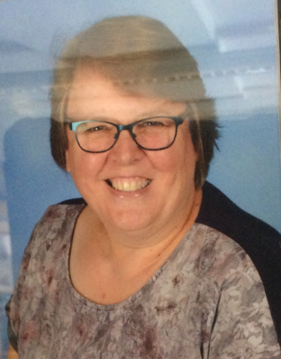
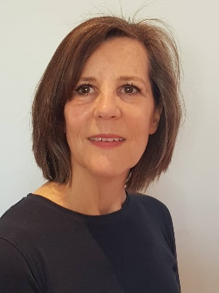
Support Workers
Family Support Worker – Gail Meaney
SENCo – Christine Cartlidge
Pre-School Link Worker – Kate James
Notes:
Laura O

Slide 10
Absences
We request early notification of absences by note or a telephone call to the office.
A letter to the class teacher is also needed on your child’s return explaining your child’s absence.
Official holiday forms are available from the office.
It is at the Head teacher’s discretion whether an absence is authorised but these can only be granted in EXCEPTIONAL &/or UNIQUE CIRCUMSTANCES.
100% Harry! – our own ‘Attendance Santa Claus’!
Notes:
Laura O

Slide 11
Late Arrivals
If for some reason you arrive late to school (after 9.00am when classroom doors are shut for the safeguarding of all children) please bring your child round to the office.
You will be asked to complete an entry into the ‘Late Book’ so that the office team can ensure children are marked on the register and their lunch is booked.
Persistent lateness is treated in the same way as unauthorised absence.
Notes:
Laura O

Slide 12
Medical Information
It is very important that any serious illnesses and allergies are clearly indicated on the ‘All About Me’ form. It is also vital that the school has an up-to-date address and telephone number where you, or someone of your choice, can be reached in an emergency.
We will always administer or oversee asthma medication or any prescribed medication. To do this we will need you to complete a consent form, please ask in the office.
If your child has actually been sick or had a stomach upset, please keep them at home for 48 hours before returning them to school.
Notes:
Laura O

Slide 13
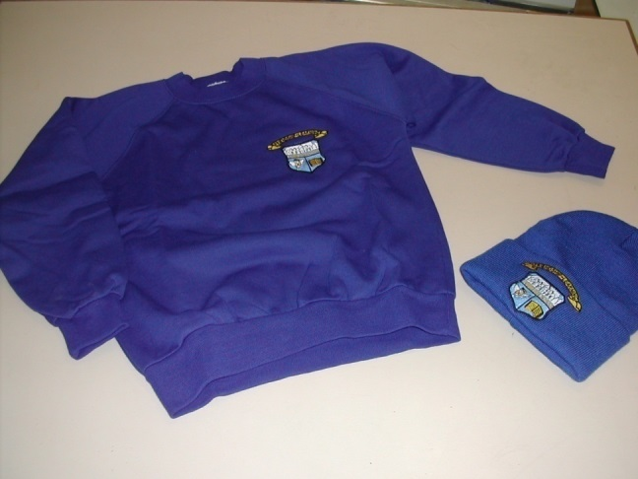
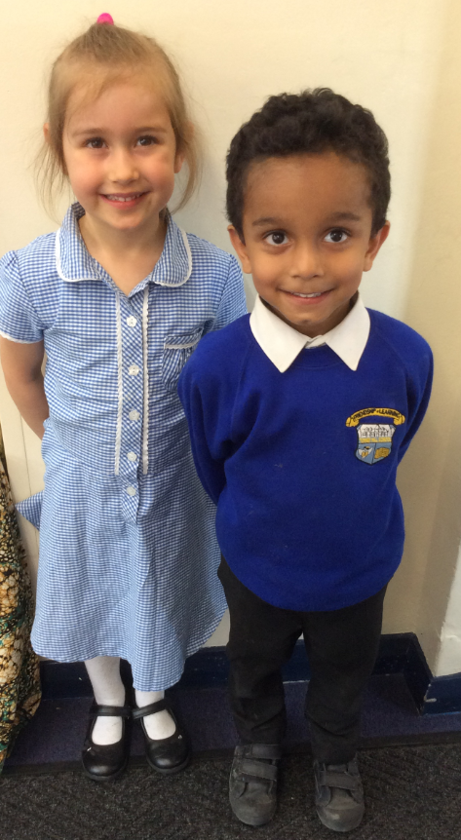
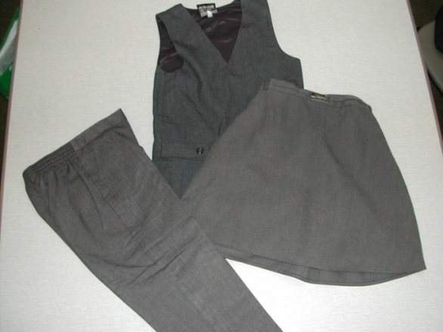
School Uniform
Smart Award!
Notes:
Nicola

Slide 14
Please ensure all your child's
belongings are clearly named!
Notes:
Nicola

Slide 15
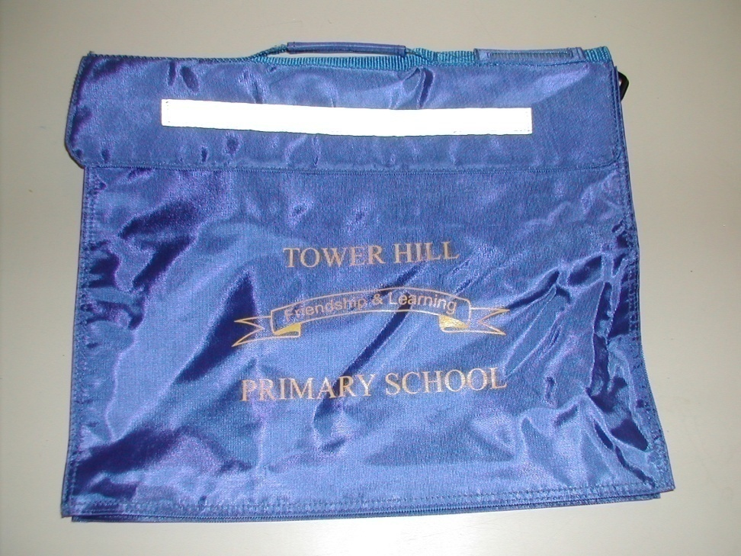
Book Bags
Book bags can be purchased from the school office.
These bags not only protect school books, but also help to ensure that letters are not lost in transit!
Notes:
Nicola

Slide 16
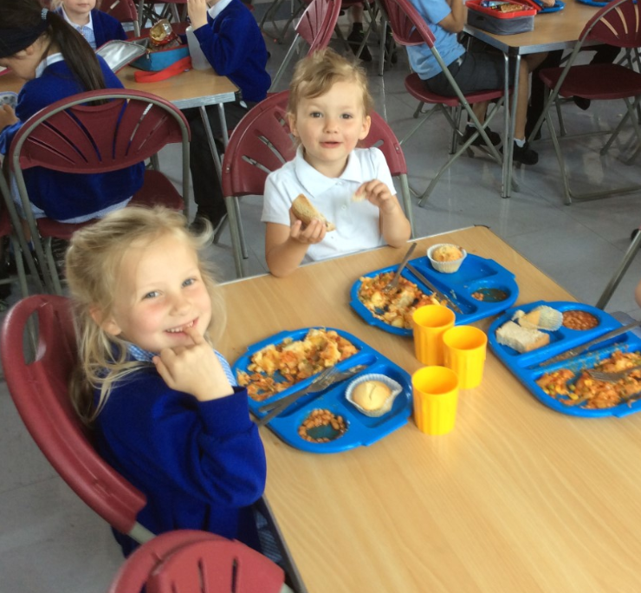
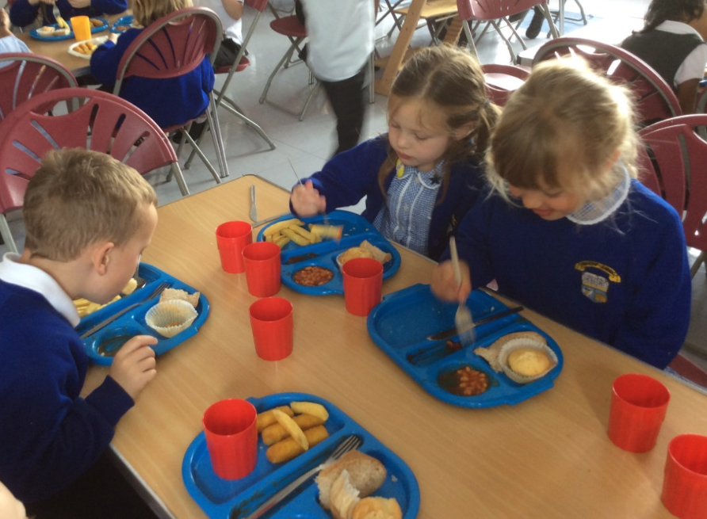
School meals
Packed lunch or school dinner.
School dinners are now free to all children in the Early Years and Key Stage One.
You will receive a termly menu so you can help your child to choose a school dinner. They will be asked to select from a choice of three nutritious meals every morning. One of these meals is always a vegetarian option.
Arrangements can be made for children with allergies.
Notes:
Nicola

Slide 17


Pupil Premium
Depending on the benefits that you receive can mean that your child is ELIGIBLE for Free School Meals
ALL Early Years and ‘Infant’ (Key Stage I) children are now ENTITLED to INFANT Free School Meals
If you are ELIGIBLE for FSM, your child will be able to attend our Breakfast Club from 8.00am until 8.45am
A nutritious breakfast + playing games and/or using the IT Suite – all supervised activities
Support for School Visits – which we value highly and include across our whole school curriculum
Additional Adult Support in the classroom which is so valuable to support children’s development
Even if you are unsure whether you are entitled – please fill it out anyway!
Notes:
Laura O

Slide 18
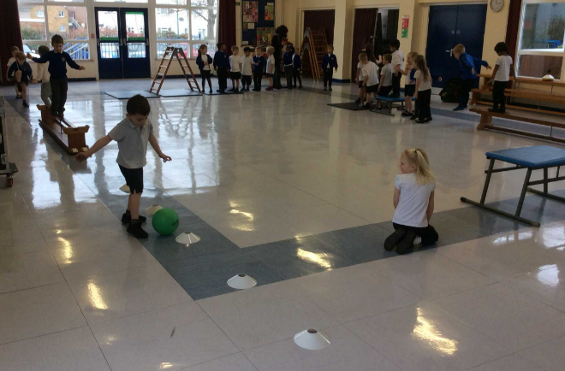
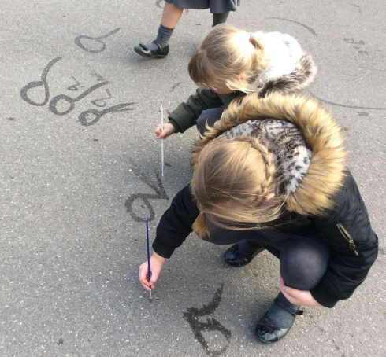
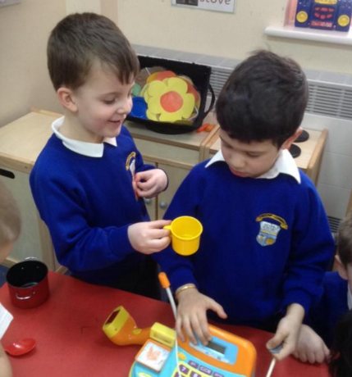
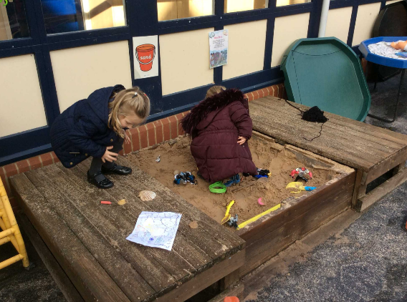
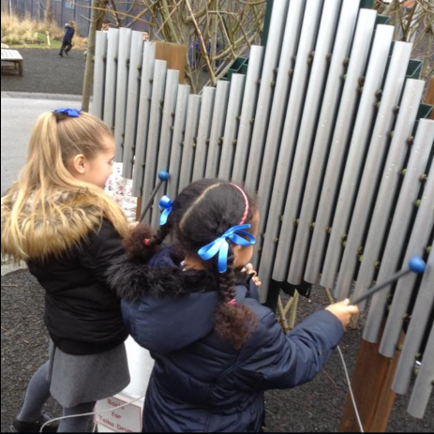
The Early Years Curriculum
Much of your child’s early learning will take place through play.
The curriculum is split into 7 areas of learning.
Physical Development
Communication and Language
Personal, Social and Emotional Development
Notes:
Laura E
7 areas of learning - Curriculum is split into 7 areas
Physical development – includes P.E, outdoor games, riding bikes, fine motor control
Communication and language – making up stories, listening and following instructions
Personal, social and emotional development – making friends, turn taking, understanding rules and routines,

Slide 19
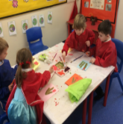
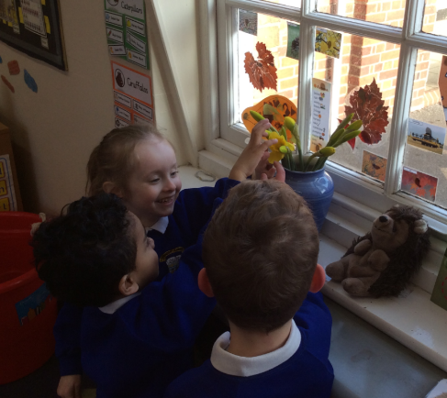
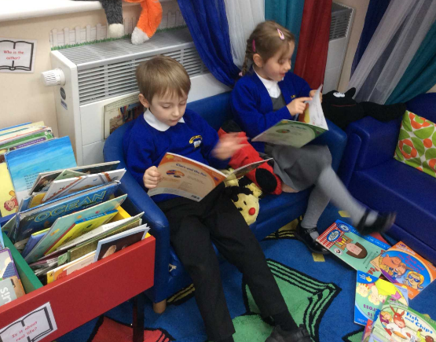
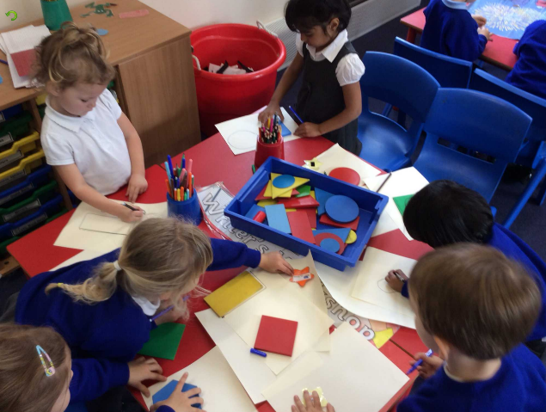
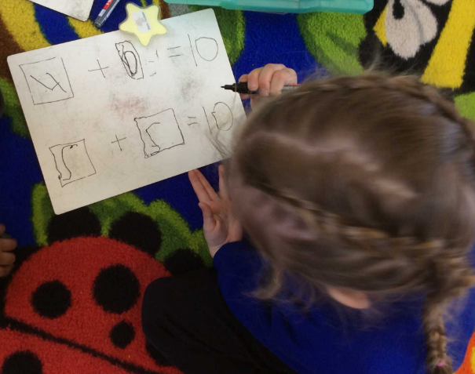
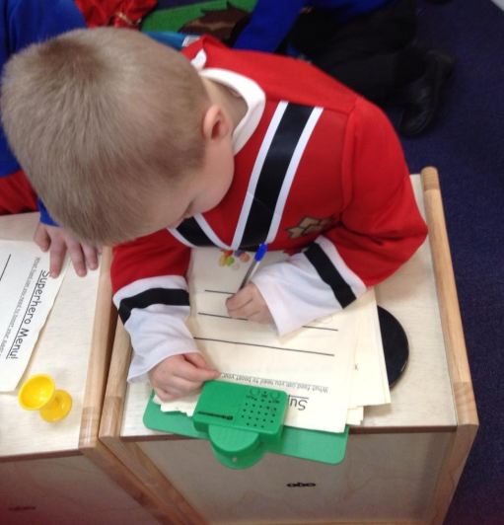
Understanding
of the World
Expressive Arts and Design
Literacy
Mathematics
We will share more information on our curriculum in the Autumn term
Notes:
Laura E
Expressive arts and design – craft, collage, playdough, imagination, role play
Understanding of the world – family traditions and festivals, understanding jobs people do, ICT
Maths – number knowledge, shape, space and measure
Literacy – reading, writing, phonics

Slide 20
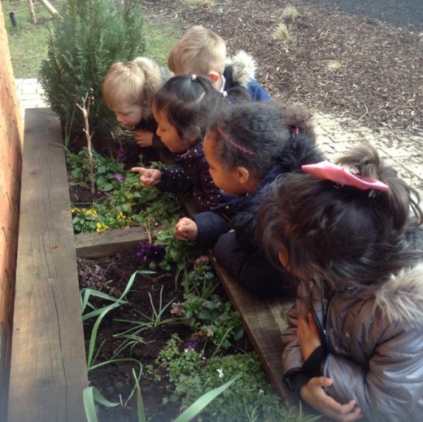
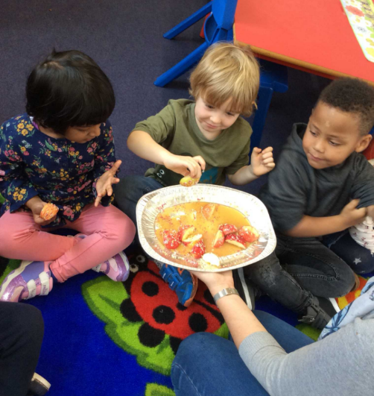
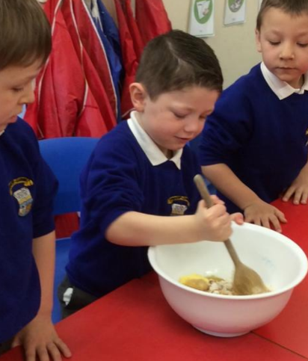
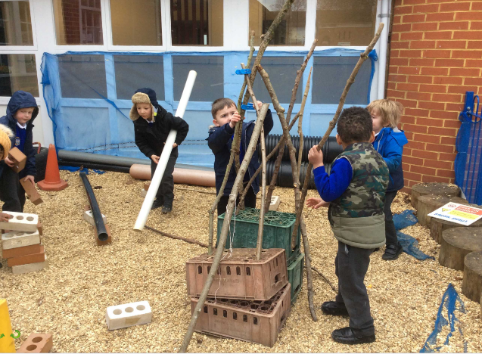
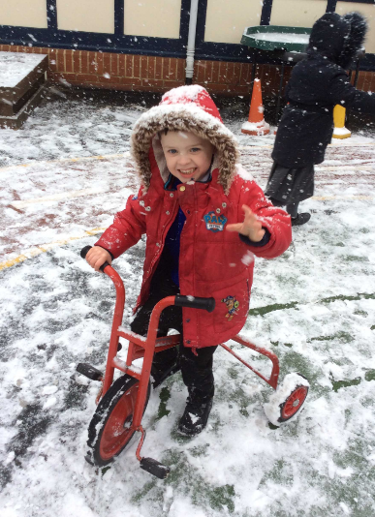
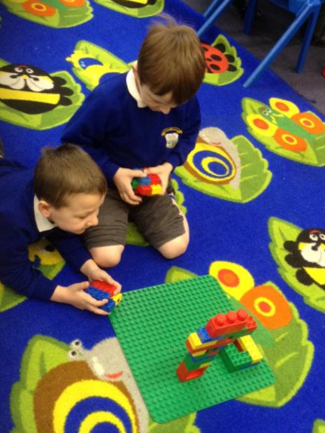
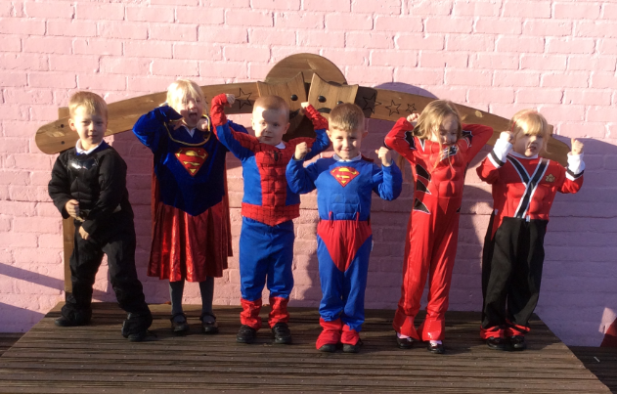
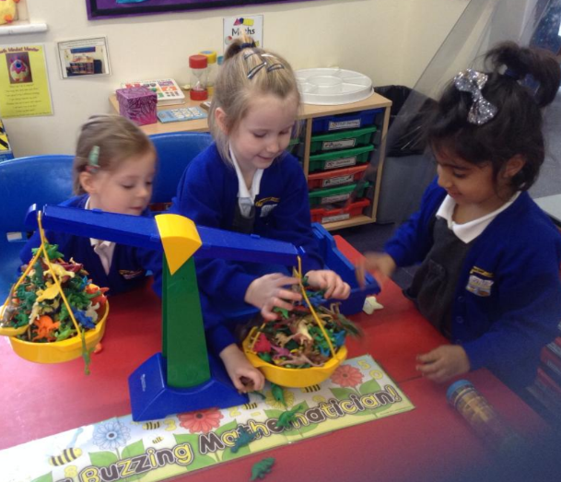
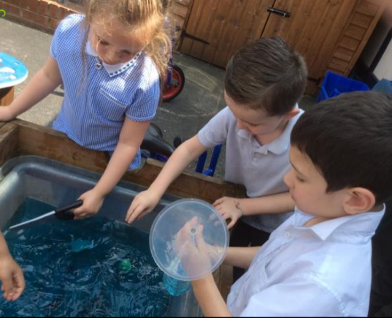
Fun!
Notes:
Laura
Most importantly we want the children to be happy and have fun!!!

Slide 21
The Early Years DVD
Notes:
Play DVD - Example of some of the things they might get up to
Receive our brand new DVD before the holidays

