Slide 1
Year 6 SATs Information Session

Slide 2
What are SATs?
SATs are standardised assessment tests administered by primary schools in England to children in Year 2 and Year 6 to check their educational progress. They are one marker used by the government, and hence parents, of the quality of the education at a school. The setting and marking of SATs are carried out in UK schools by the Standards & Testing Agency
SATs are a useful tool to see how well a child has progressed from KS1 to KS2, and they also give secondary schools a base to compare against when the time comes for your child to leave Year 6 and make the journey up to KS3!
Useful information for Secondary Schools
Tests are taken during a week in May
Tested on maths, reading and grammar
Writing is based on Teacher Assessment
Tuesday 9th May – Friday 12th May

Slide 3
Scaled Scores – what are they?
What is meant by ‘scaled scores’?
It is planned that 100 will always represent the ‘national standard’.
Each pupil’s raw test score will therefore be converted into a score on the scale, either at, above or below 100.
Using the scaled score, the lowest a child can score is 80, with the highest being 120.
A child who achieves the ‘national standard’ (a score of 100) will be judged to have demonstrated sufficient knowledge in the areas assessed by the tests.
Each pupil receives:
- a raw score (number of raw marks awarded);
- a scaled score in each tested subject;
- confirmation of whether or not they attained the national standard.

Slide 4
How do the tests take place?
The tests all take place in normal school time, under test conditions.
Pupils will not be allowed to talk to each other during the tests.
The completed papers are sent away to be marked externally.
Results are returned to school in July.
The tests vary in length but last no longer than 60 minutes:
- Reading: 60 minutes - Grammar, Punctuation & Vocabulary: 45 minutes - Spelling: 15 minutes - Arithmetic: 30 minutes - Mathematical Reasoning: 2 papers of 40 minutes each.

Slide 5
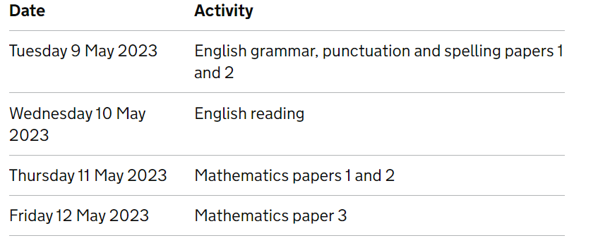
What do SATs look like at Tower Hill?
Children are well prepared throughout the year
SATs practice weeks at regular intervals
Children will be spread out in different areas of the building – they will be used to this.
Year 6 curriculum lends itself for preparing the chn for the tests as well as enhancing their knowledge, skills, enthusiasm and engagement in many other areas of their learning.

Slide 6
Sats week
To help ensure the children achieve their best during that week the school day will look slightly different:
Breakfast
Snack before the test
Opportunities to recap or discuss areas they are less confident with
Brain breaks in between tests
Active and/or creative afternoon sessions
Please ensure the children arrive on time and having had a good nights sleep!

Slide 7
Reading
The reading test consists of a single test paper with three unrelated reading texts. Children are given 60 minutes in total, which includes reading the texts and answering the questions.
A total of 50 marks are available.
Questions are designed to assess the comprehension and understanding of a child’s reading.
During the reading paper, a child’s inference and deduction skills are thoroughly tested. They will also be expected to answer questions on authorial choices: explaining why an author has chosen to use particular vocabulary, grammar and text features.
Some questions are multiple choice or selected response; others require short answers and some require an extended response or explanation.

Slide 8
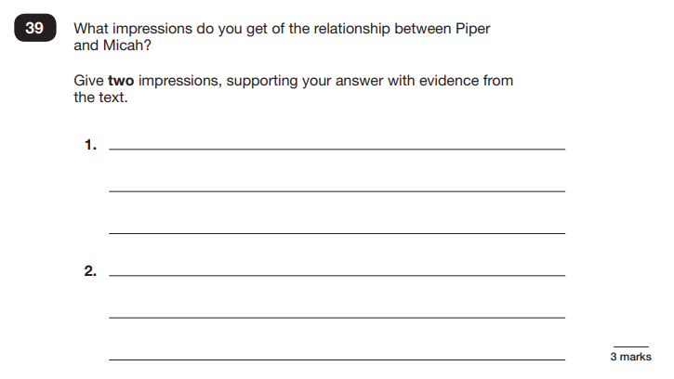
Example Questions

Slide 9
Example questions

Slide 10
Spelling, Punctuation and Grammar
A spelling test is administered containing 20 words, which lasts approximately 15 minutes.
A separate test is given on grammar, punctuation and vocabulary.
This test lasts for 45 minutes and requires short answer questions including some multiple choice.
Marks for these two tests are added together to give a total for grammar, punctuation and spelling.

Slide 11
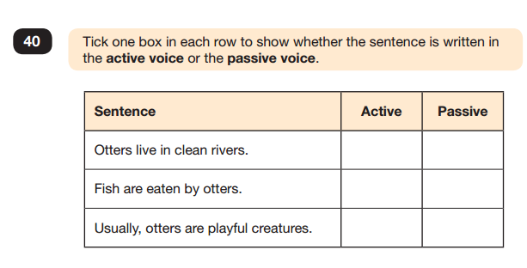
Sample questions

Slide 12
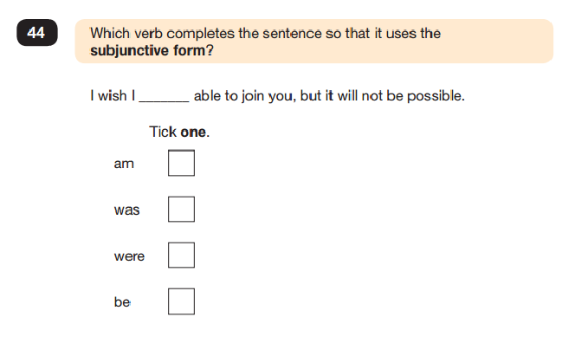
Example questions

Slide 13
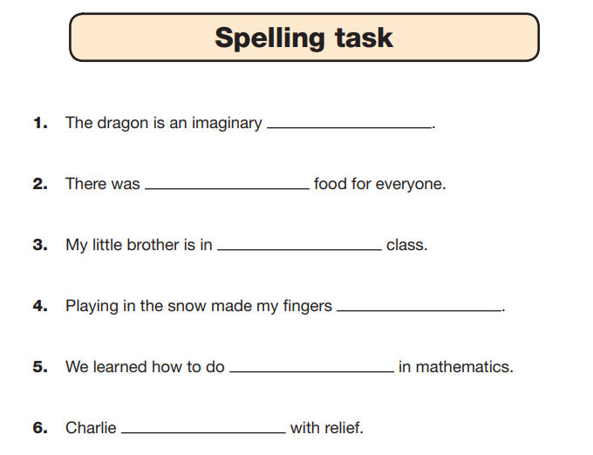
Example questions

Slide 14
Mathematics
Children will sit three tests: paper 1, paper 2 and paper 3.
Paper 1 is for arithmetic, lasting for 30 minutes, covering calculation methods for all operations, including use of fractions, percentages and decimals.
Questions gradually increase in difficulty. Not all children will be expected to access some of the more difficult questions later in the paper.
Papers 2 and 3 cover problem solving and reasoning, each lasting for 40 minutes.
Pupils will still require calculation skills but will need to answer questions in context and decide what is required to find a solution.

Slide 15
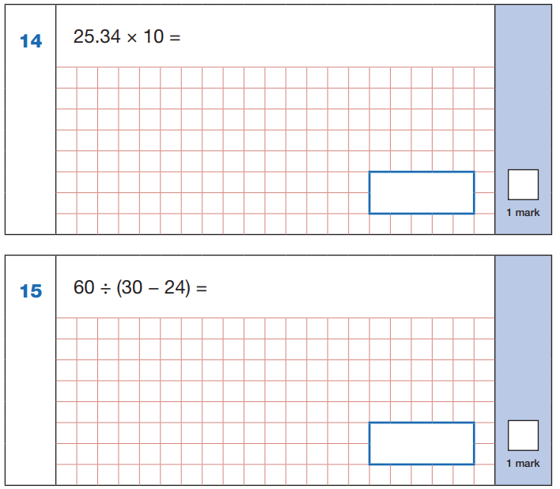
Example questions

Slide 16
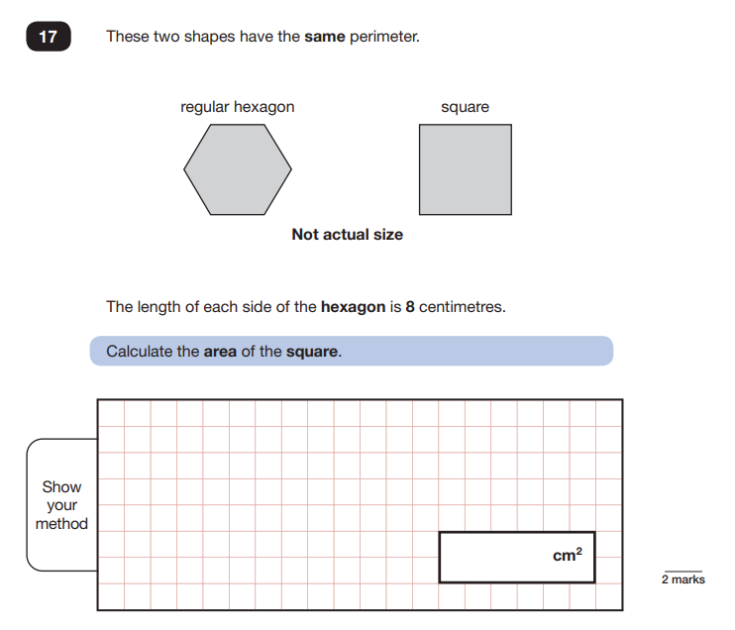
Example questions

Slide 17
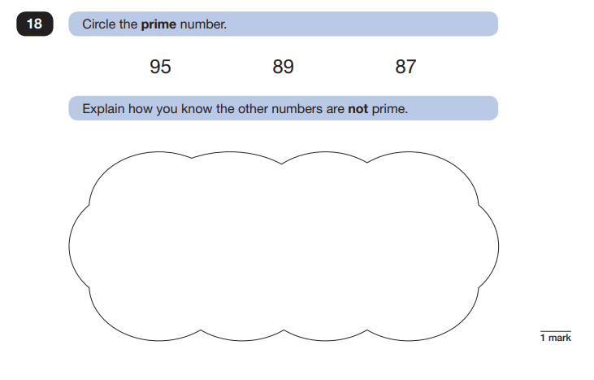
Example questions

Slide 18
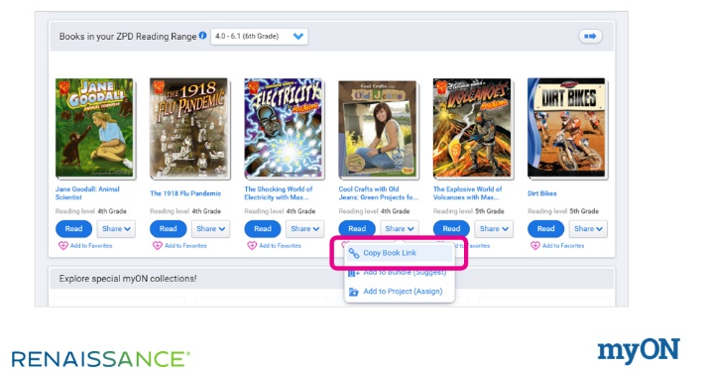
Academic Support in school and at home
Learning in school
Year 6 Team
Constant assessment of previous learning
Reading every day
Focus on timetables
How can you support learning at home?
Listening to your children read out loud and questioning them about the plot etc
Use of TTRS, MyMaths, Homework

Slide 19
Supporting our children’s well-being
PE sessions each week
Golden Mile
Outdoor Learning
PHSE sessions
Zones of Regulation
Regular bedtimes in the week
Reduced screen time
Helping chn to timetable their homework
Family time

Slide 20
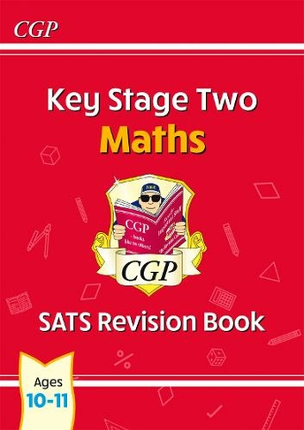
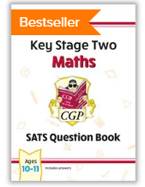
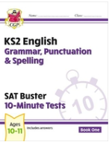
Revision Materials

