Slide 1
BLUE SPARKLE TEST

Slide 2
1. Can you count out loud to ten for me please ?

Slide 3
2. Can you write the number seven please?

Slide 4
3. How many red dinosaurs are there?

Slide 5
4 – Can you draw me 8 dots on your board please?

Slide 6
5– How many dogs are there?

Slide 7
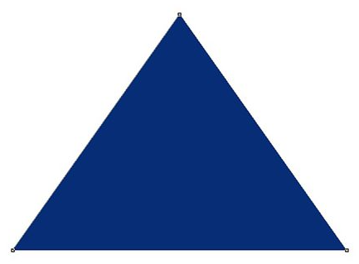
6. How many triangles are there? 7, 8 or 9?

Slide 8
7. What number is one more than 4 ?

Slide 9
8. How many sweets have I got in total?

Slide 10
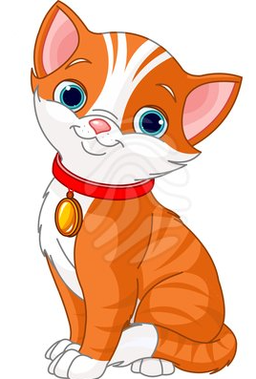
9. - Who has more sweets the dog or the cat?

Slide 11
10. Can you put these numbers in the correct order from smallest to biggest? 9, 3, 7, 1

