Slide 1
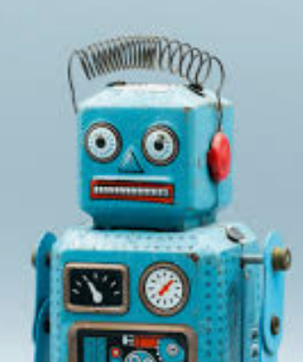
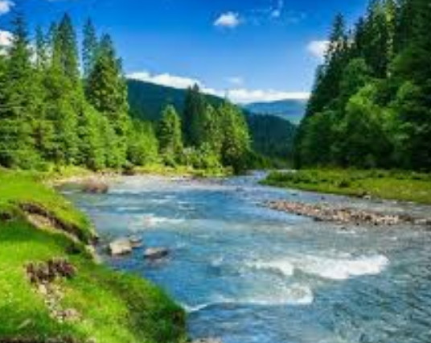
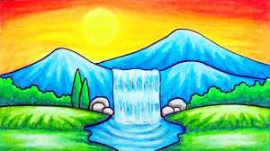
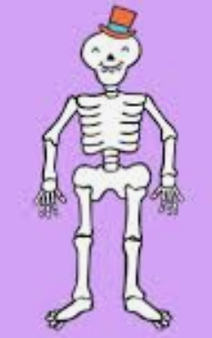
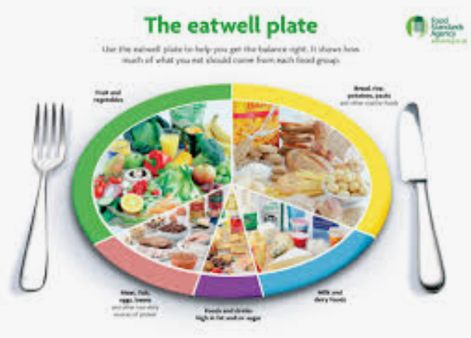
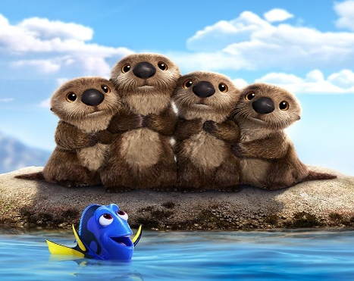
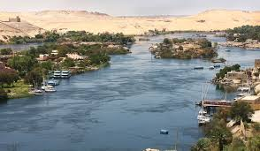
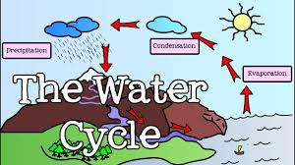
Rolling like a River!
Year 3 Homework – Autumn 1
Choose up to 3 tasks from this homework menu. You can bring homework into school at any time but the deadline is Friday 25th October
Design or make your own robot and write a short description | Draw or paint a picture of a river scene. You could use water colours, pencils or anything you like to create it. | Draw a picture or write a description of your dream school. | Write an Acrostic poem about a River. R I V E R
Make a healthy lunch and explain why it is healthy and send me a picture. | Do some exercise – you could go on a long walk or a bike ride. | Make your own skeleton. | Do something to help the environment – go litter picking in your local area.
Describe to someone how the water cycle works or create a poster to explain it. | Research and draw a creature who lives in a river. | Play on TTRS every week (more if you can) | Create a fact file about a famous river.

